Slide 1
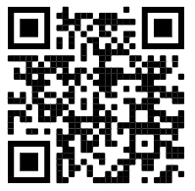


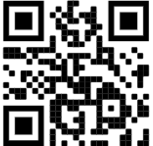
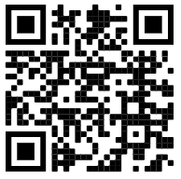
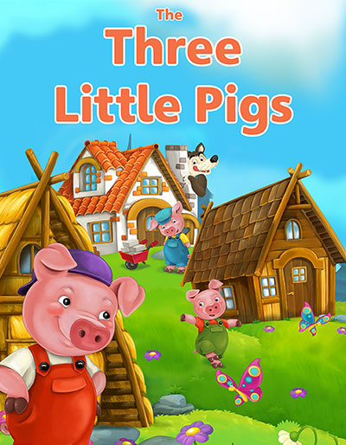
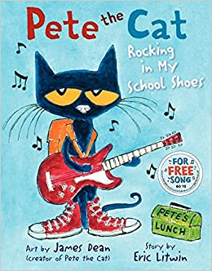

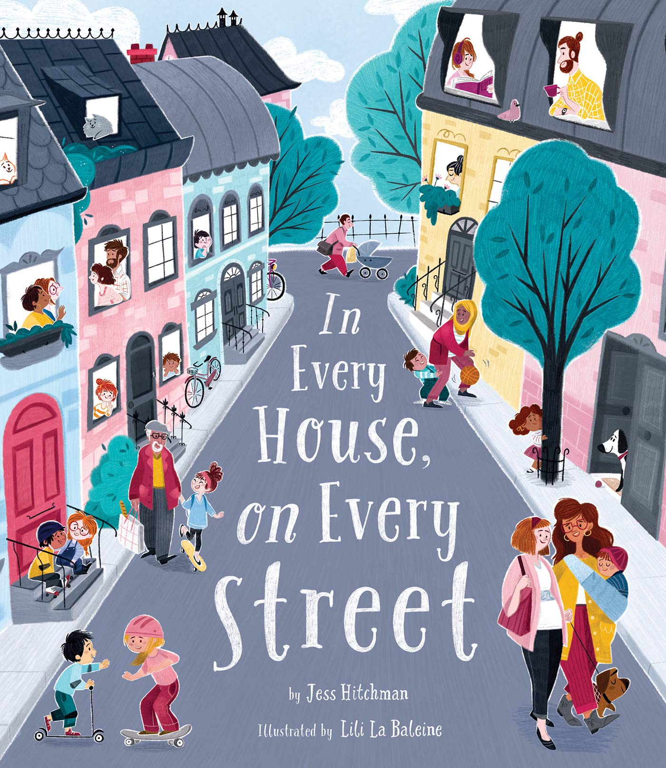

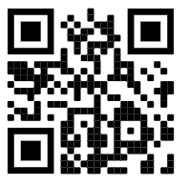
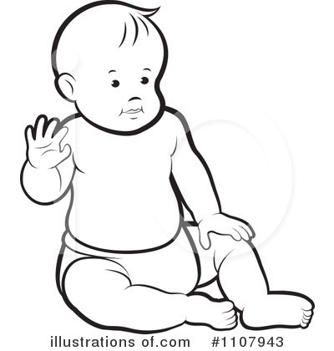

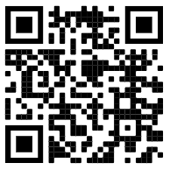
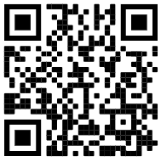
FS2: Knowledge Organiser: Autumn 1: It’s good to be me
How can you learn at home?
Encourage independence -
Teach your child how to get dressed independently, including putting on their own coat and shoes.
Our Family -
Can you name the members of your family? Can you talk about the things you like to do as a family?
Create a picture of your family/ make a family tree.
What special events have you shared together as a family?
Find a photograph of your family and bring it to school to share with your class.
Please remember to bring your ‘All about me’ bag into school by the 17th September 2021.
Singing/Rhymes
Practise singing nursery rhymes.
Key Books this term:
Pete the Cat - Rocking in my school Shoes
This book is all about Pete and his fun day at school.
Key vocabulary: school, community, classroom, corridor, dinner hall, library, playground.
In every house and on every street!
The Whale Song
This book will help us to learn all about different communities.
The children will be talking about their families and learning about our local community.
Vocabulary: family, mum, dad, brother, sister, grandad, grandma.
Houses and Homes around the World
The Three Little Pigs
We will be talking about the houses that we live in, exploring houses in our local community and comparing those to houses around the world.
Vocabulary: house, flat, bungalow, terraced house, window, door, roof, chimney, garden, fence, wall.
Possible experiences:
Tour of the school, creating a photo montage of our school, rules and routines, gratitude board (5 main classroom rules), designing our own coat peg label, learning about the roles of important people in our school.
Possible experiences:
We will be talking about our families, who is special to us, sharing our ‘All about me’ bags, drawing pictures of our families and learning learn to draw a self portrait, bringing in a family photo. We will also begin talking about how we have changed, “When I was a baby”.
Possible experiences:
Learning about our local community, where we live, the houses we live in, comparing our houses to those around the world. Retelling The Three Little Pigs, investigating building materials, introducing our work bench, building a house and starting our breakfast bar. .
Songs / Rhymes
“When I was a baby..”
Days of the week
Wash your hands
Starting School
“Now that I am older I can…”
Spring | Summer | Autumn | Winter

Slide 2

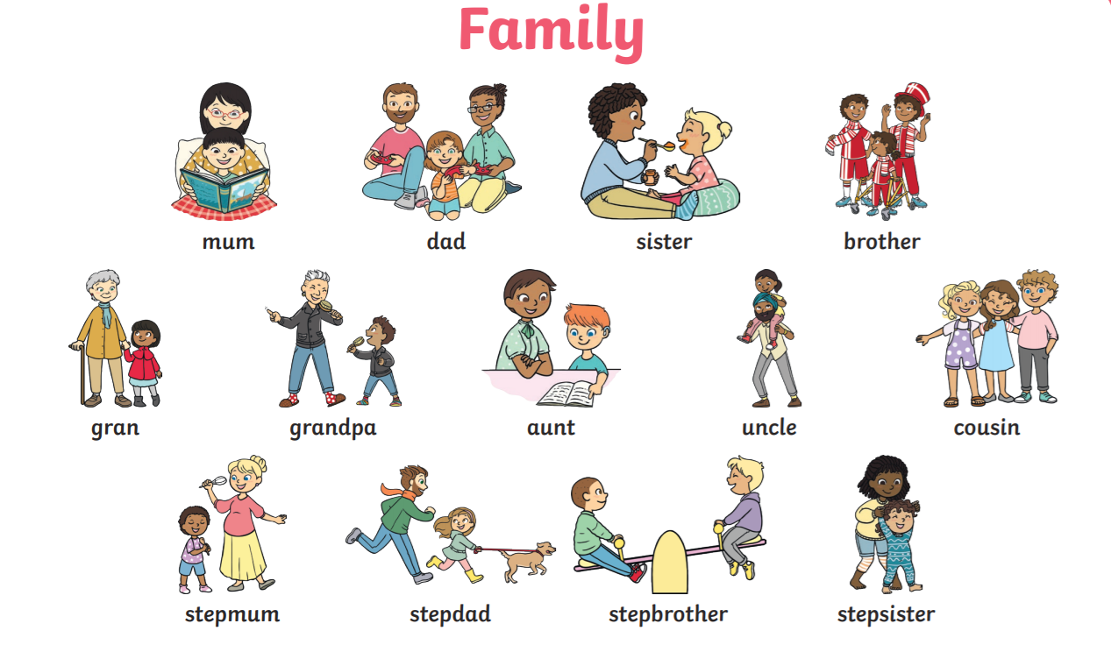



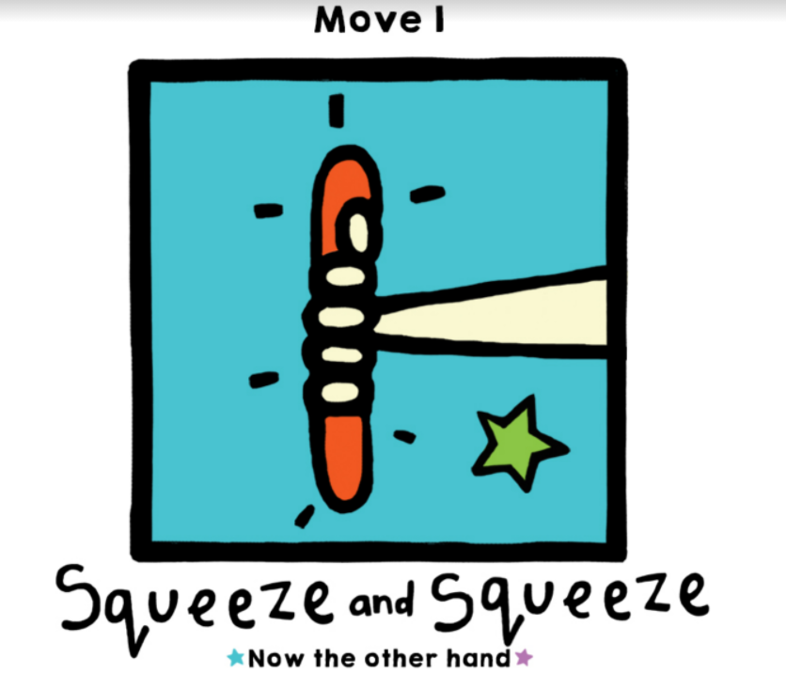
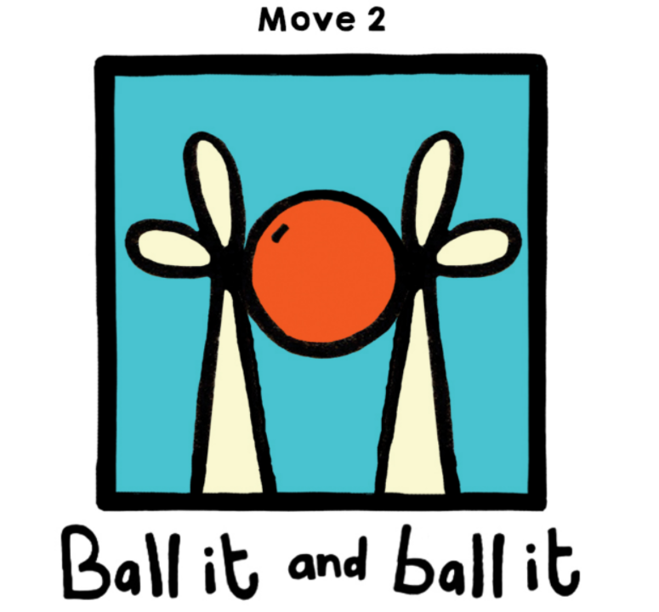
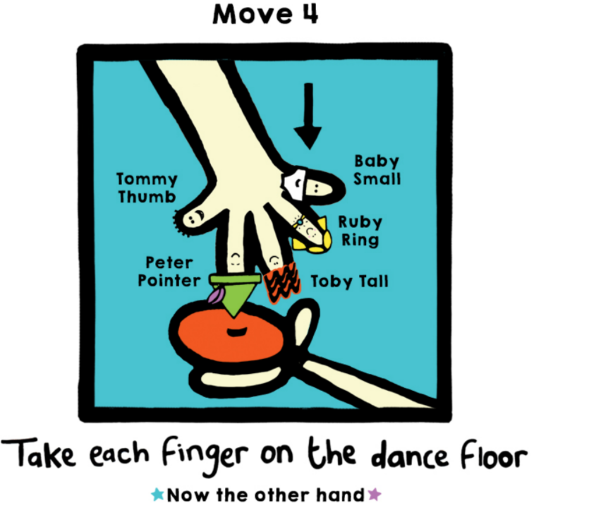
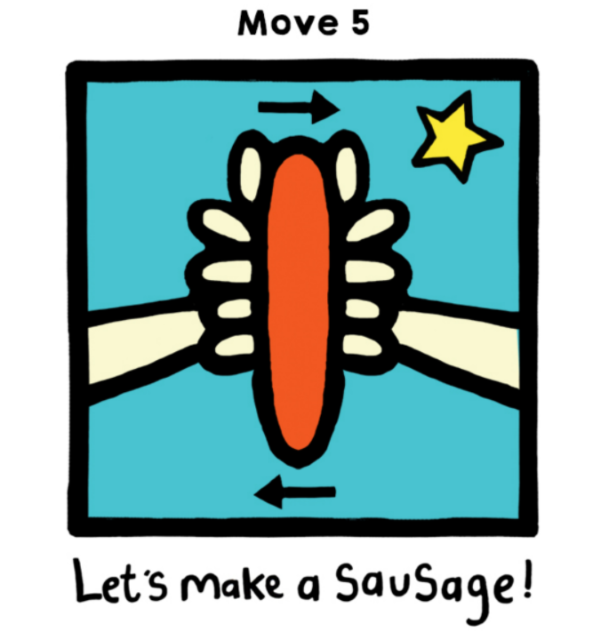
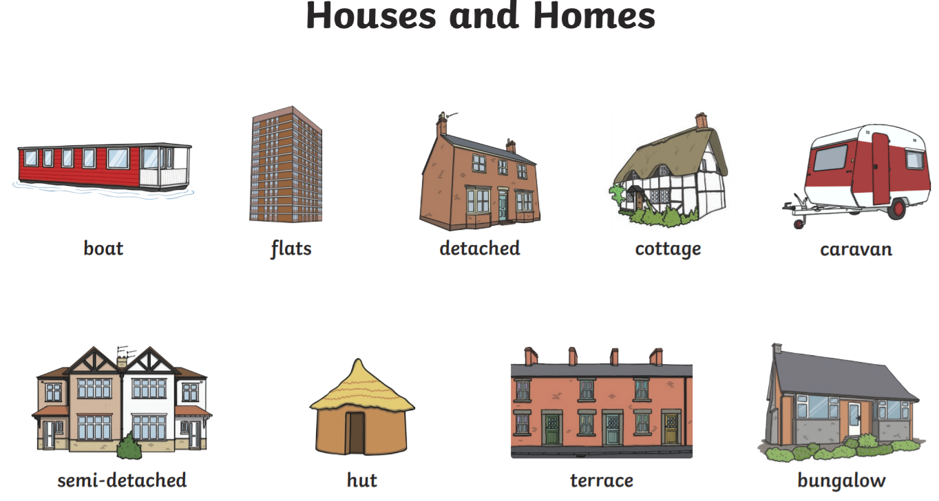

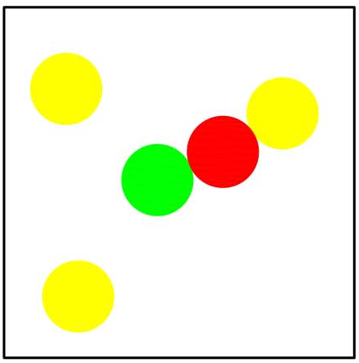



Key Vocabulary:
Music: Pulse : the regular heartbeat of a piece.
I can keep a steady pulse with some accuracy.
I can imitate movements in response to music.
Physical Development: Gross and Fine motor Skill
Squiggle Wiggle: Gross and fine motor movement using wavy lines, zig zag lines and arches.
Dough Disco : Fine motor control using dough to practise squeezing, balling the dough, separating each finger to push the dough and also rolling a sausage shape.
Physical Development - Spatial awareness / Funky Feet
We will be playing listening and attention games PE that will involve the children negotiating the space around them, carefully changing direction etc. Further develop the skills they need to manage the school day successfully:
lining up and queuing, mealtimes, personal hygiene.
Expressive Arts and Design: Art /D&T
Painting and drawing focus: using colours for a purpose and specific tools for using lines and circles to represent shapes and objects. \
We will be choosing colours for a purpose when we are learning how to draw a self portrait.
Tool bench / area learning how to small ‘Tap Tap’ boards and small hammers to tap pins into a cork board to make a picture using wooden shapes.
Maths: Number and Place Value. Numbers to 5
Subitising: is the rapid, accurate, and confident judgments of numbers performed for small numbers of items.
Comparing groups within 5 - using amounts up to 5 we will be
comparing different numerical representations.
Comparing quantities of identical
Objects / non identical objects
Can you play subitising dice or card games at home?
Literacy: Reading
Recapping concepts of print
Phase 1: hearing initial sounds, oral blending.
Literacy: Writing: We will be working on pencil grip, ensuring
correct formation of letters in our name and giving meaning
to our marks and symbols.
Oral blending - this is when you blend the sounds together to say the word (cat). We use a blending arm motion from left to right to help blend the sounds together.
PSED: Everyone’s Welcome
Red Rockets: Respectful friendships.
What would life be like if we all liked the same things?
Rainbow Jelly
Respectful friendships.
Is it ok to be different?
Tripod pencil grip

