Slide 1
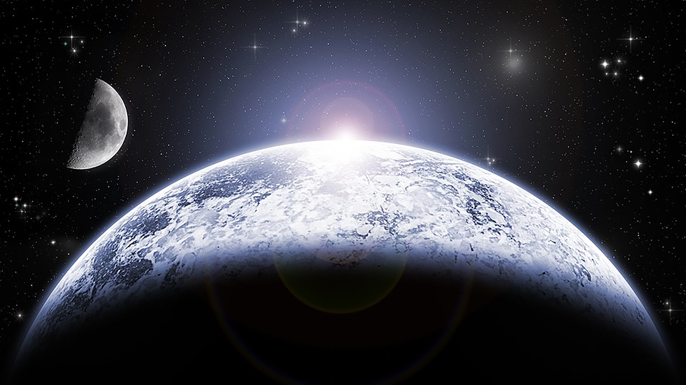
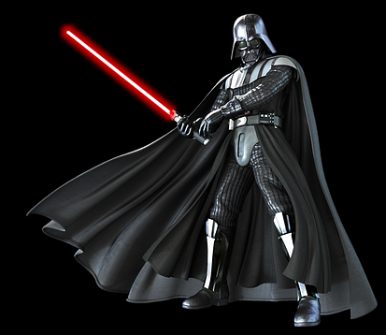
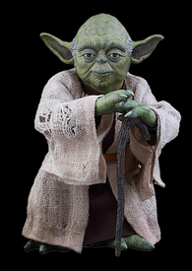
Word Wars

Slide 2
c | a | t

Slide 3
c | a | t

Slide 4
d | a | t

Slide 5
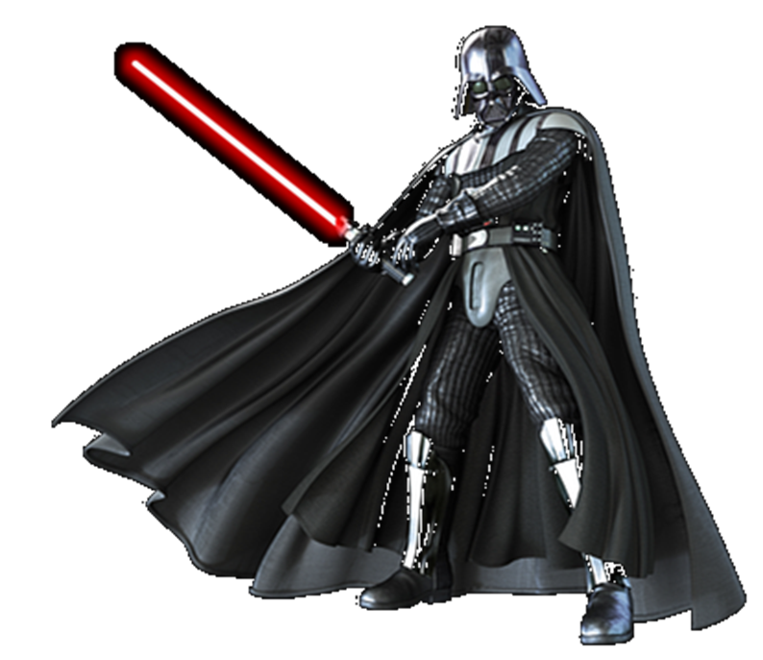
d | a | t

Slide 6
g | i | p

Slide 7
g | i | p

Slide 8
ch | i | p

Slide 9
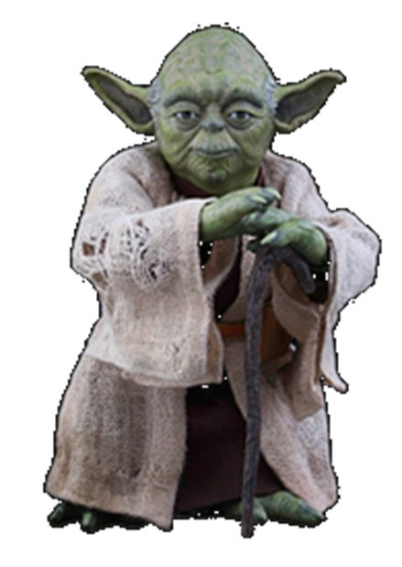
ch | i | p

Slide 10
s | l | o | p

Slide 11
s | l | o | p

Slide 12
s | a | n | d

Slide 13
s | a | n | d

Slide 14
s | t | a | n | d

Slide 15
s | t | a | n | d

Slide 16
l | i | sh

Slide 17

l | i | sh

Slide 18
f | i | sh

Slide 19
f | i | sh

Slide 20
qu | e | ck

Slide 21
qu | e | ck

Slide 22
th | e | n

Slide 23
th | e | n

