Slide 1



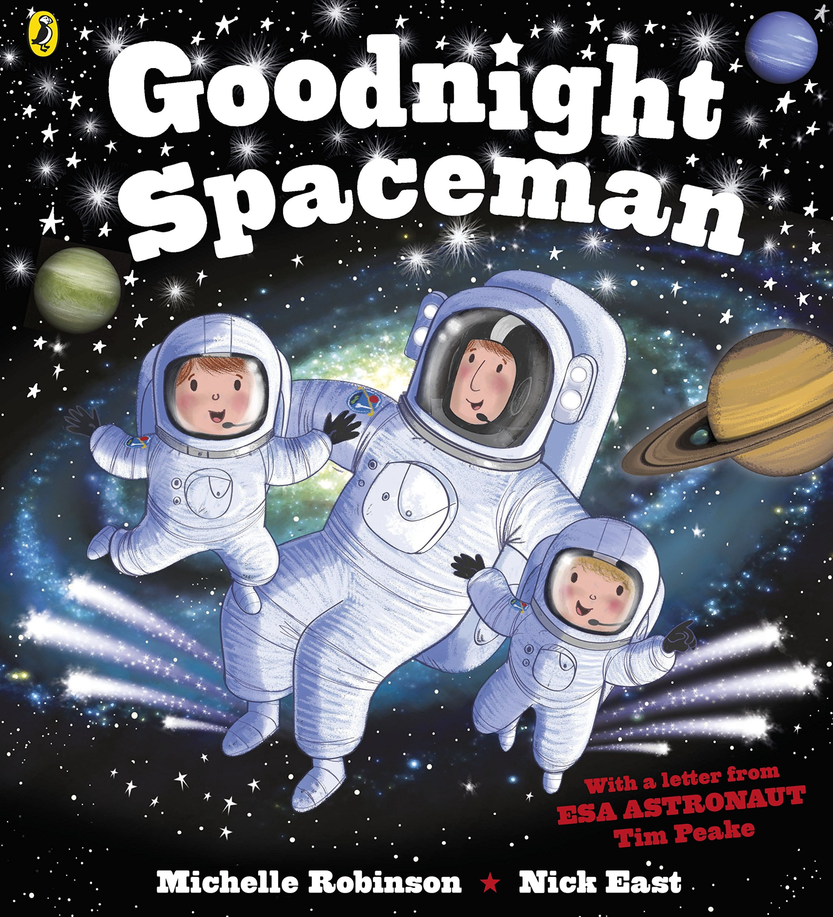
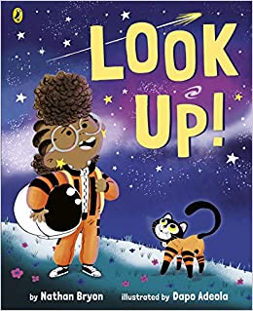







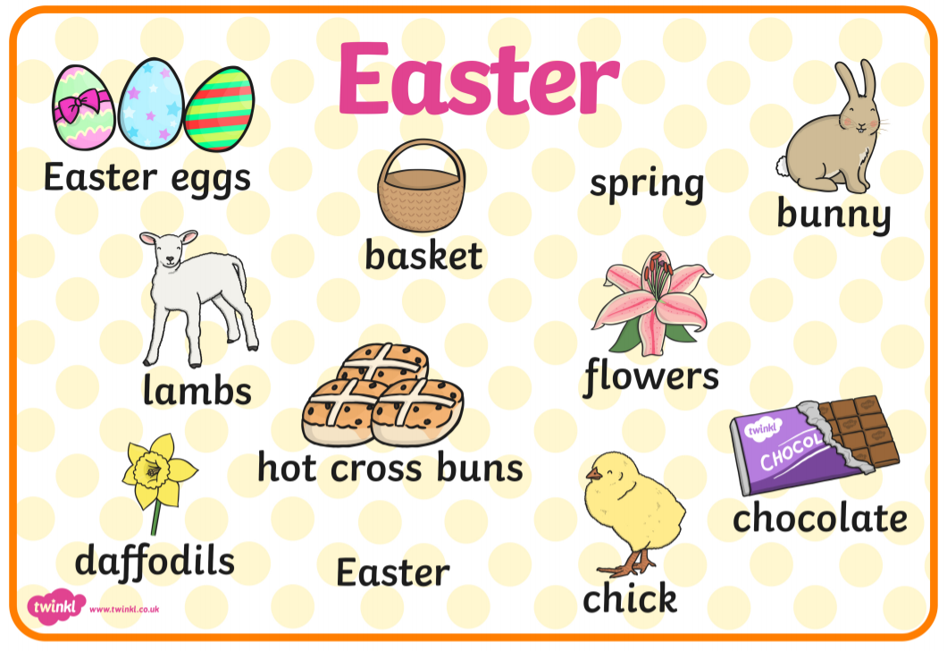
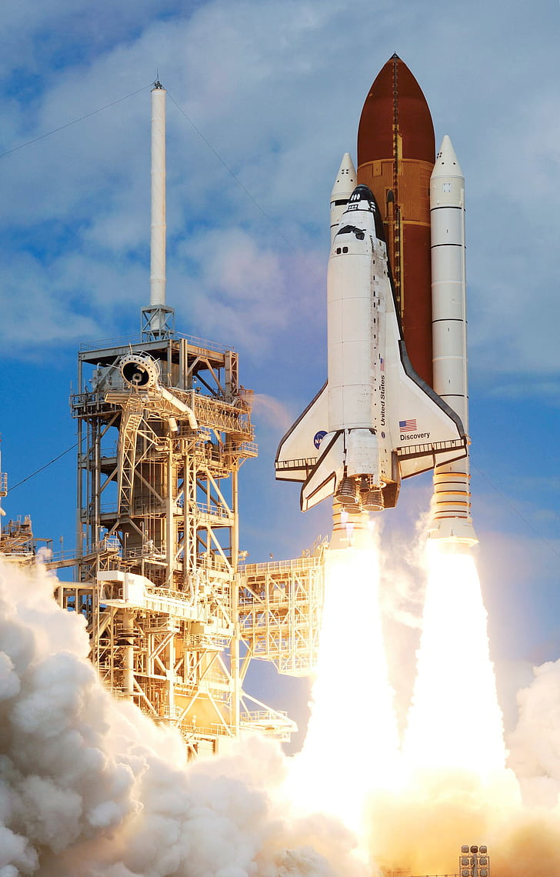
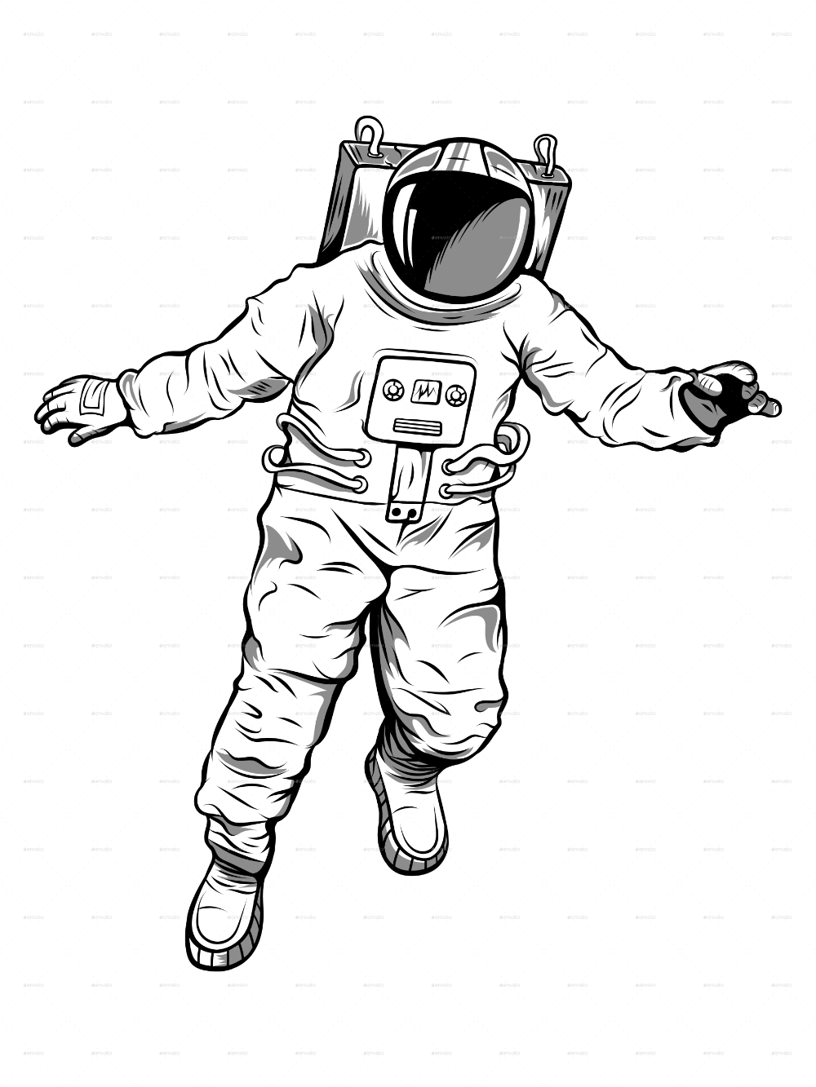

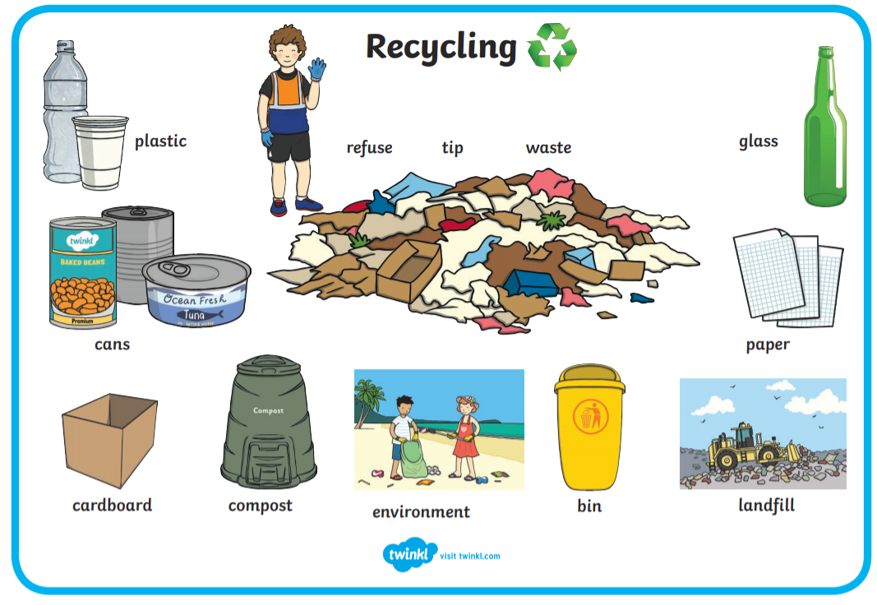
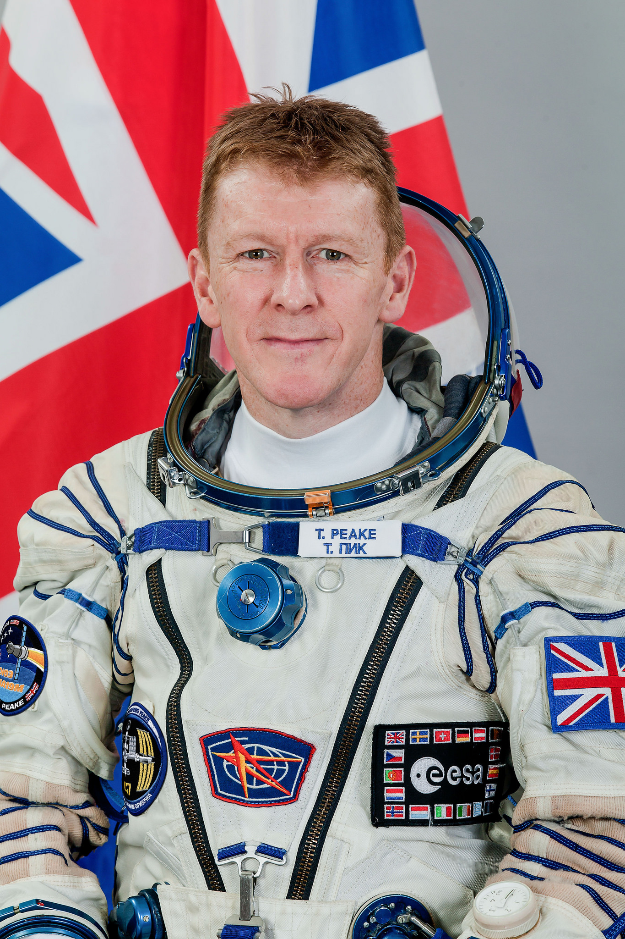
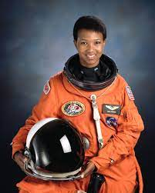
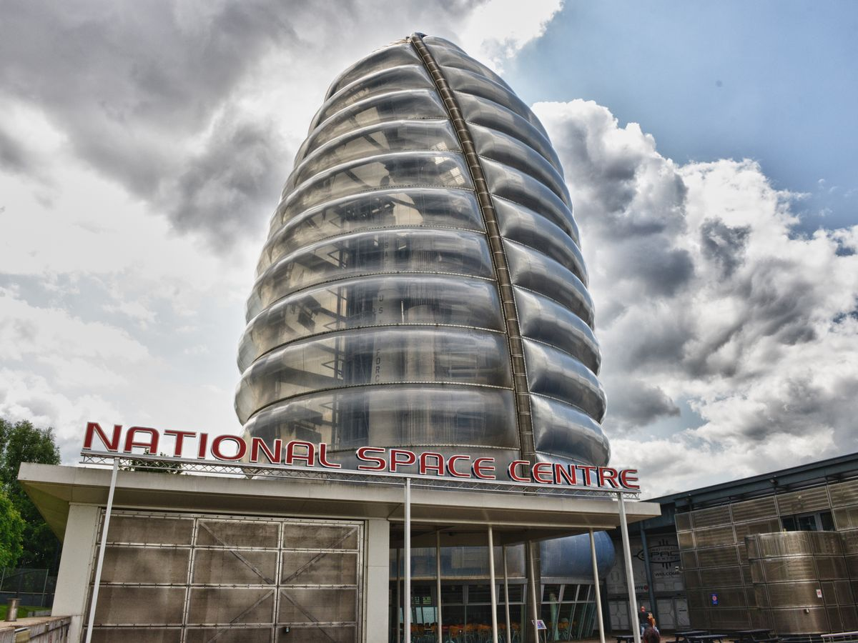

FS2: Knowledge Organiser: Spring 2: Adventure above and under the clouds
Why is space exploration important?
We’re going on an egg hunt
Possible learning experiences:
Learning about Easter / signs of spring
Outdoor numbered egg hunt
Designing repeating patterned egg designs.
Design a parachute to save an egg.
Key Books this term:
Possible lines of enquiry: Space, our local world, recycling, Easter.
The Sea of Tranquility / Goodnight Spaceman / Look Up
Possible learning experiences:
Immersive moon reading experience.
What is the moon? What is an astronaut?
Viewing footage of Apollo 11 and the first moon walk (comparing tv images to today)
Building and making rockets
Rocket launching (thurst / gravity)
Bottle cap experiment (thrust / gravity)
Rocket launch - this is when a rocket takes off towards space.
Somebody Swallowed Stanley
Possible learning experiences:
Sorting materials - recyclable, biodegradable, non recyclable.
Litter walk of local area using maps to direct.
Writing a litter song / poem and perform.
Independently access the features of a non-fiction book.
Recycling is the process of converting waste materials into new materials and objects.
Key Vocabulary: Astronaut, helmet, spacesuit, boots, belt, back pack, visor.
Can you check your recycling at home? Is it sorted correctly?
Tim Peake
Mae Jemison
Gravity - force that pulls objects toward each other. Earth's gravity is what keeps you on the ground and what makes things fall.
Thrust is the force which moves the rocket through the air, and through space.
Developing our understanding and love of story!
Retell stories in the correct sequence, draw on language patterns of stories.
Say how they feel about stories and poems, what parts of the story they liked or disliked, can identify favourite characters, events, or settings and why.
Innovate a well-known story with support.
Tim Peake was the first British Astronaut in Space.
Mae Jemison was the first black woman astronaut in Space.
Scan to visit the National Space Centre in Leicester.

Slide 2
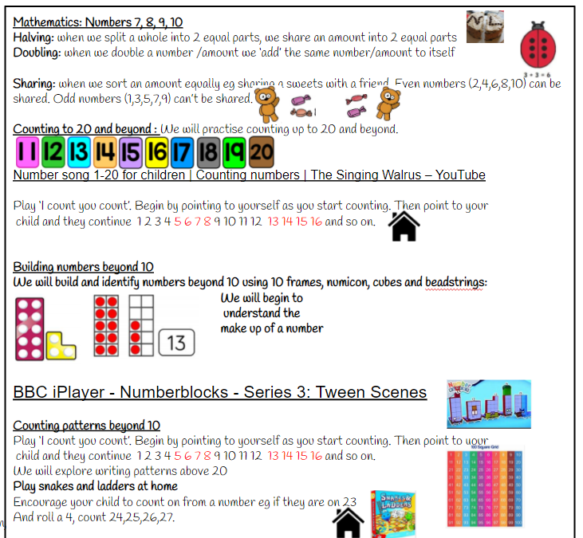
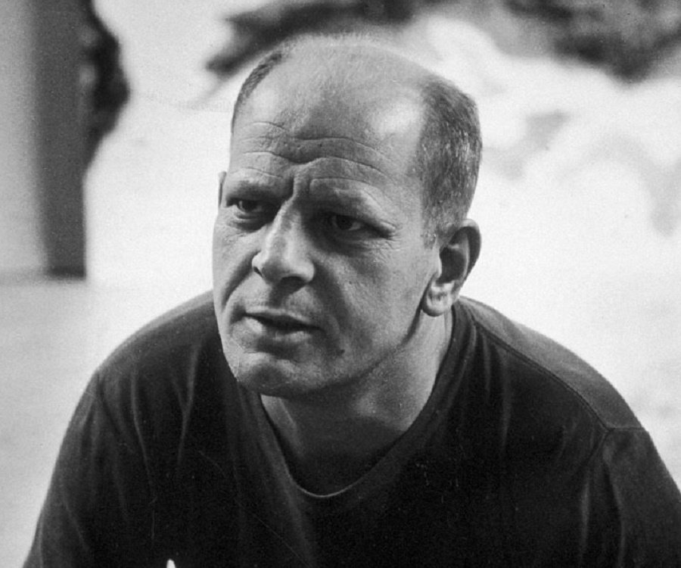
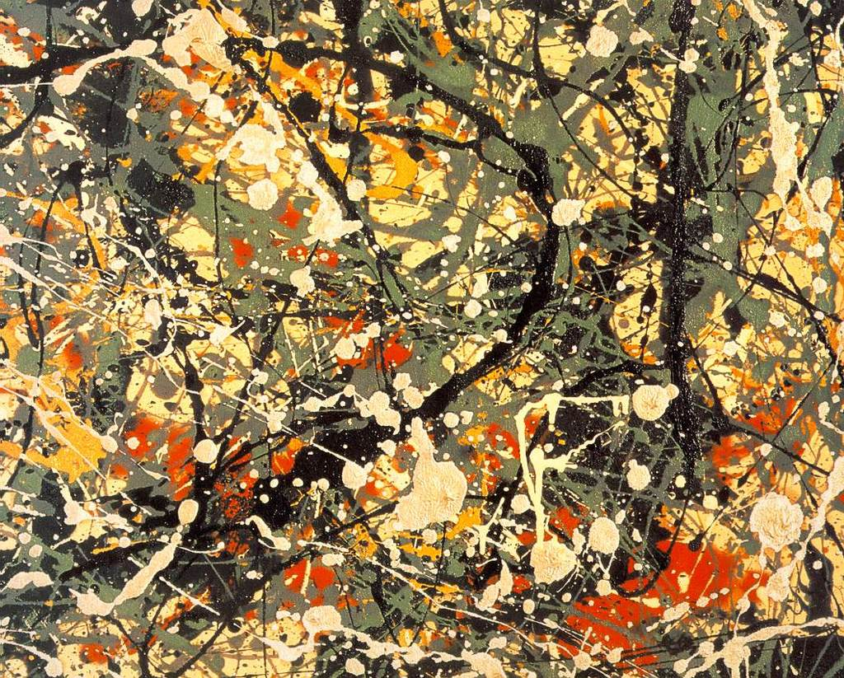
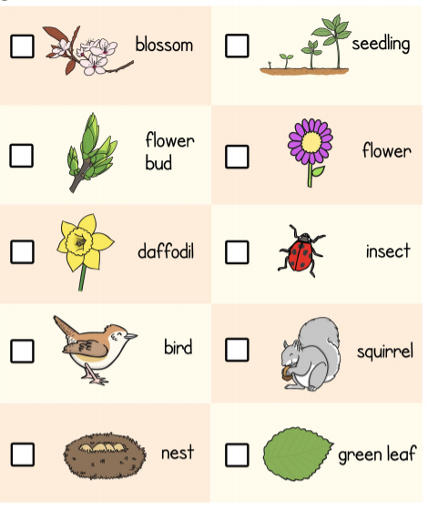



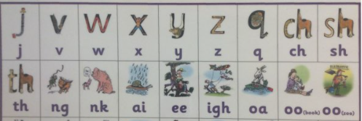
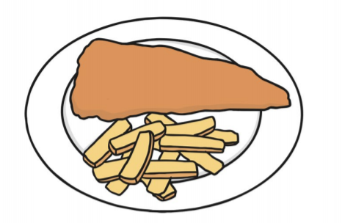


Physical Development: Gross and Fine motor Skill
Squiggle Wiggle - Gross and fine motor movement.
Physical Development - PE: Ball skills and games
I can throw underarm, throw an object at a target and catch using two hands. I can bounce and kick a ball and use equipment to control a ball.
What happens to our bodies when we exercise? We breathe more quickly, our heart beats faster and we get hotter.
Expressive Arts and Design:
Painting: Jackson Pollock
Music: Pitch
Rhythm - Rhythm is what makes music move and flow. Rhythm is made up of sounds and silences.
I can sing broadly in tune with a limited pitch range.
I can create music, and suggest symbols to represent sounds.
I can record and comment on my voice and others.
Diagonal lines
He was an abstract artist which means he used shapes and colours rather than painting real things
Pollock invented ‘paint dripping’. He used different tools to drip, pour and splatter paint onto the canvas from above.
Religious Education
Celebration: Why do hindu’s celebrate Holi?
Signs of Spring: What is spring?
Looking for the signs of spring on a spring walk: Going on a spring hunt!
Ipads; take photos of the signs of spring using a check-list.
The Easter Story: Who is Jesus?
We will learn about why we celebrate Easter.
We will be exploring painting using tools to drip, pour and splatter.
Collaborative painting - movement and feeling to music and creating a space backdrop.
Jigsaw: Dreams and goals: Setting a goal!
Mental Well being: What does it mean to feel proud?
Everyone’s Welcome: Blue Chameleon
Literacy: Reading
Literacy: Writing
Begin to orally compose and write a simple sentence with support
Continue to learn Phase 3 sounds
Spell to write VC, CVC and CVCC words independently using Phase 2 and phase 3 graphemes.
Spell some irregular common (tricky) words e.g., the, to, no, go independently.
Oral Segmenting - this is when you split a word up into its individual sounds (c-a-t). We call this ‘robot talk’.
Scan to hear Phase 3 sounds.
Orally compose (say) a phrase /sentence.
Tap, clap, stomp.
Count how many words.
Say first word / robot the word / write the word.
Oral blending - this is when you blend the sounds together to say the word (cat). We use a blending arm motion from left to right to help blend the sounds together.
Holds a pencil effectively to form recognisable letters. Know how to form clear ascenders and descenders.
Using our phonics to help us read:
Blend and segment known sounds for reading
Read simple phrases and sentences made up of words with known letter–sound correspondences and, where necessary, a few exception words.
The fish and chips are on the dish.
ascenders
b d h k l t
j p q y
Can you design and write a card for a friend?
Can you write simple instructions to make your favourite food?
Can you write a daily diary?
descenders
f
Digraph: two letters that make one sound.
Trigraph: three letters that make one sound.
Can you practise ascenders and descenders?

